Slide 1






RERA NO.: RAJ/P/2025/3524
AT VILLAGE :- DAHAR & SALAGRAMPURA, TEH.:- CHAKSU, JAIPUR.

Slide 2
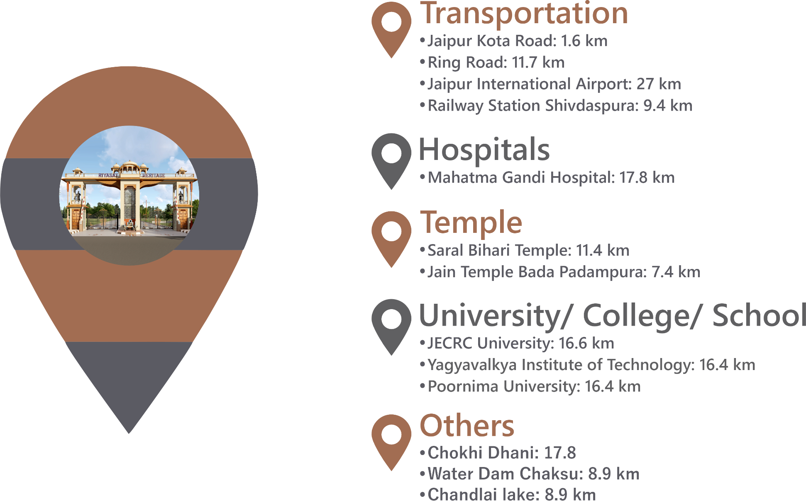
DISTANCES
NOTE: The distances mentioned are approximate and aerial, provided for general reference only. These are not precise measurements and should be considered as rough estimates.

Slide 3
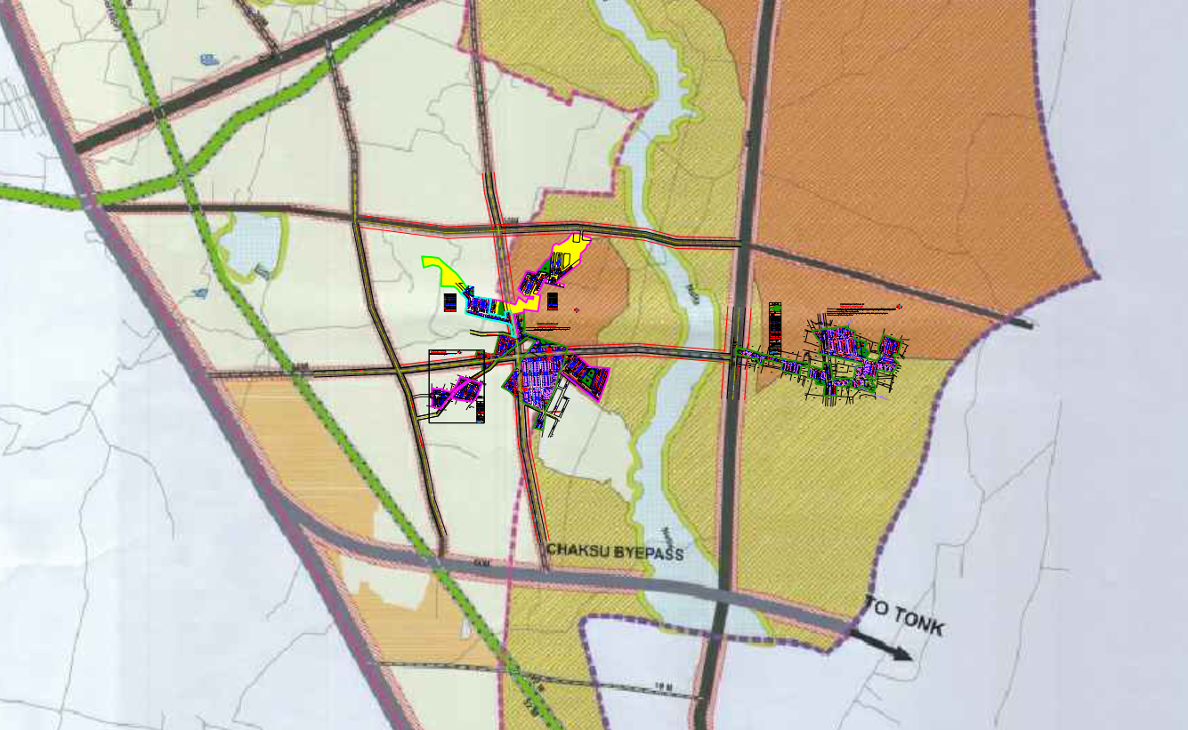

Slide 4


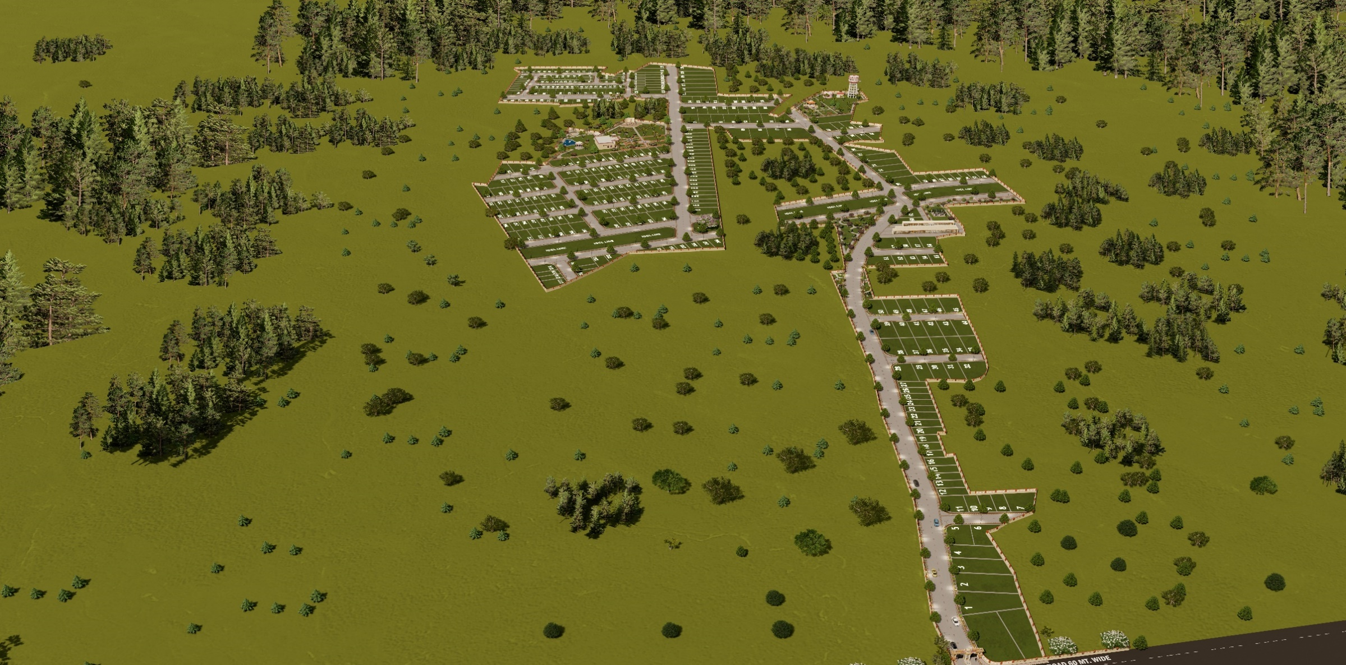
AERIAL VIEW

Slide 5
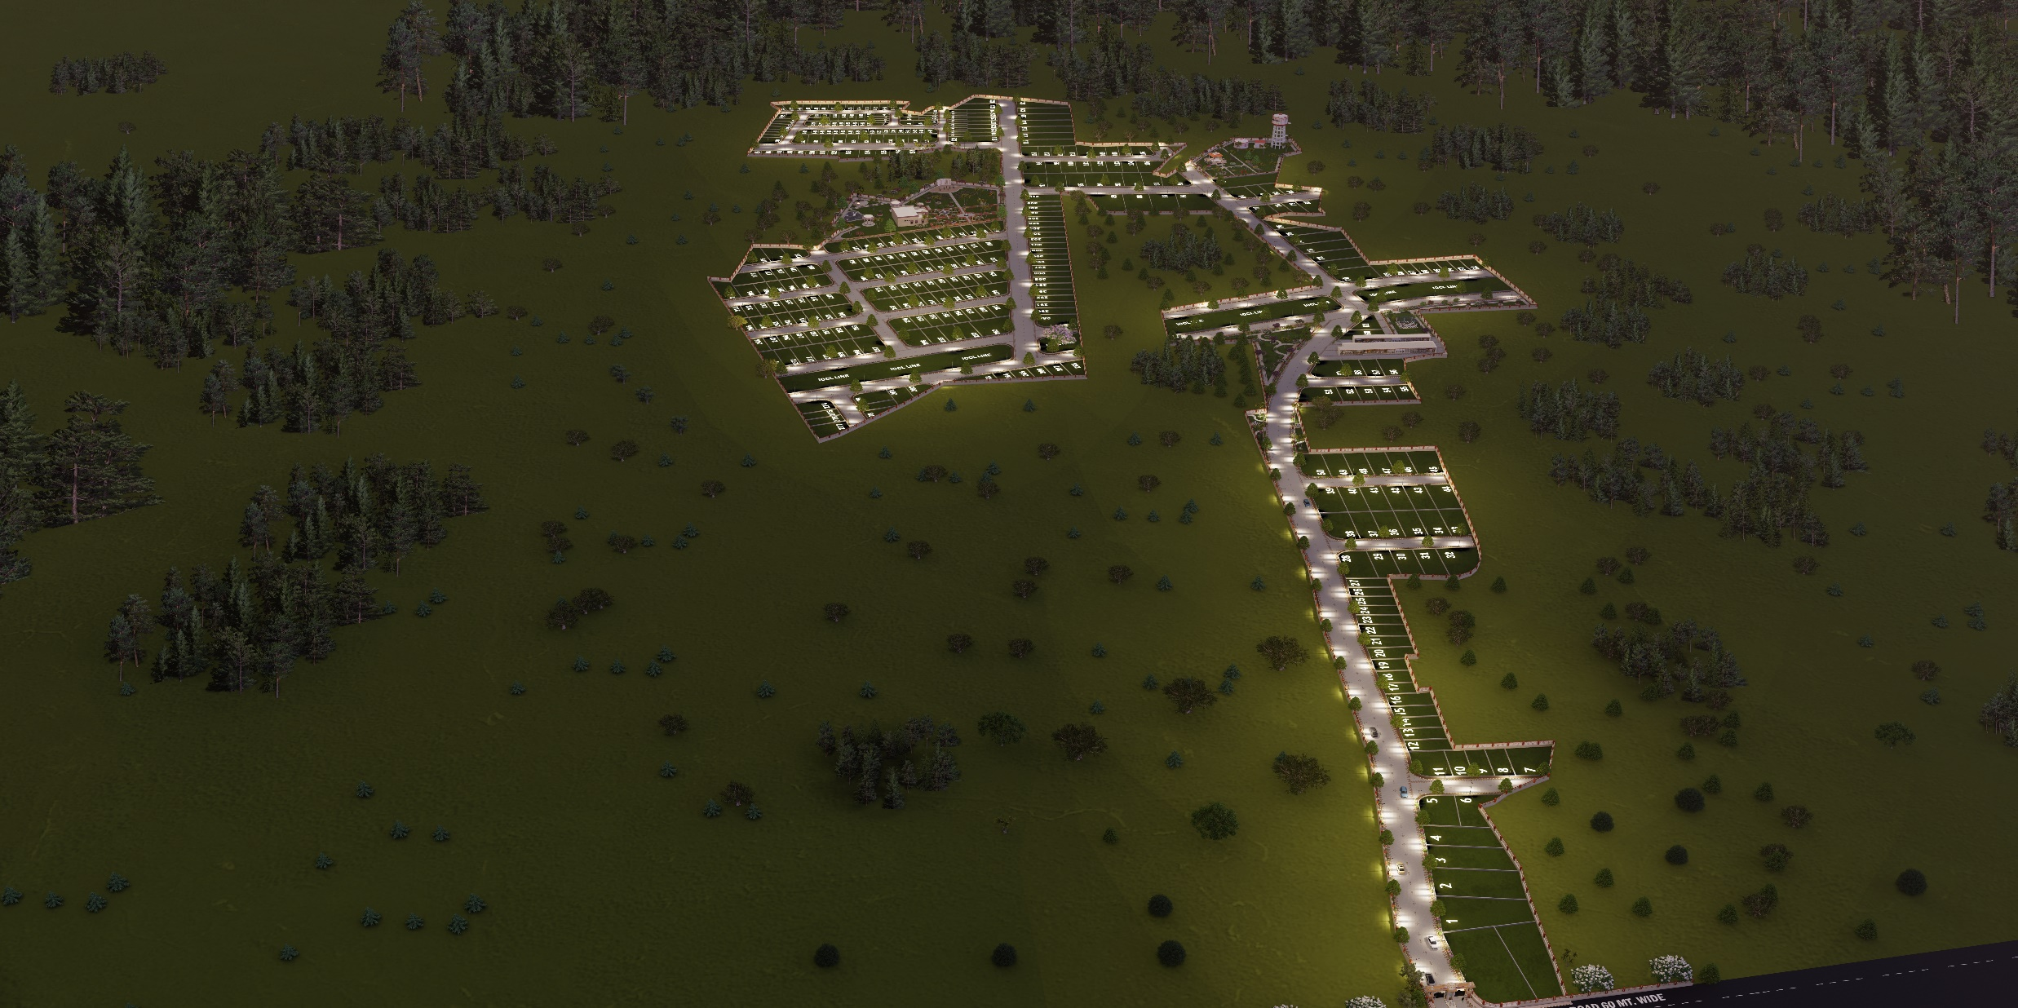
NIGHT AERIAL VIEW

Slide 6
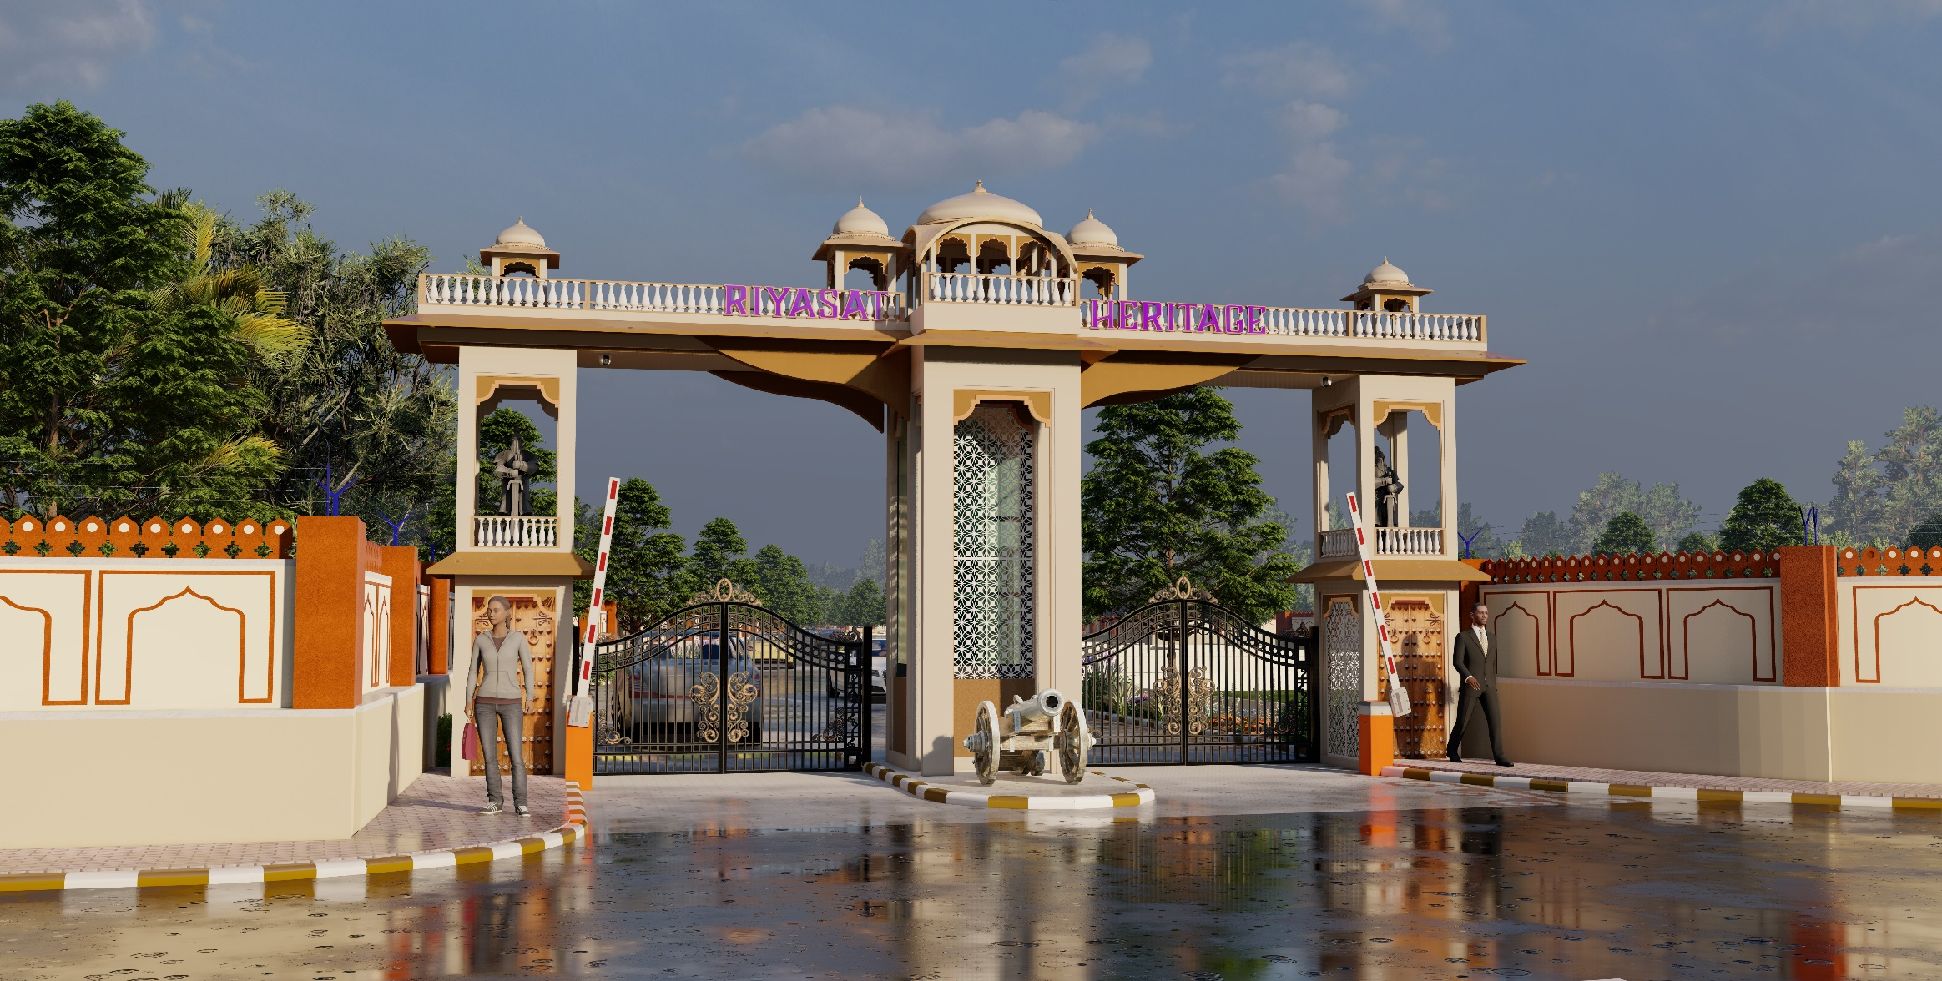
ENTRY GATE

Slide 7
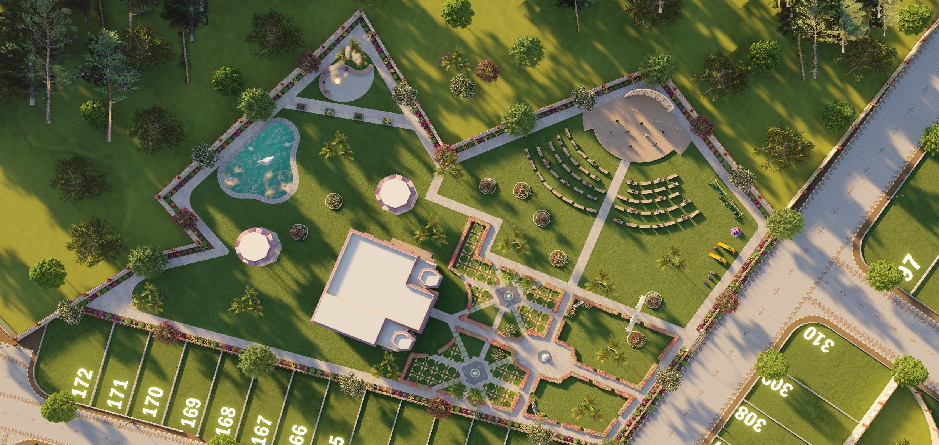
PARK AERIAL VIEW

Slide 8
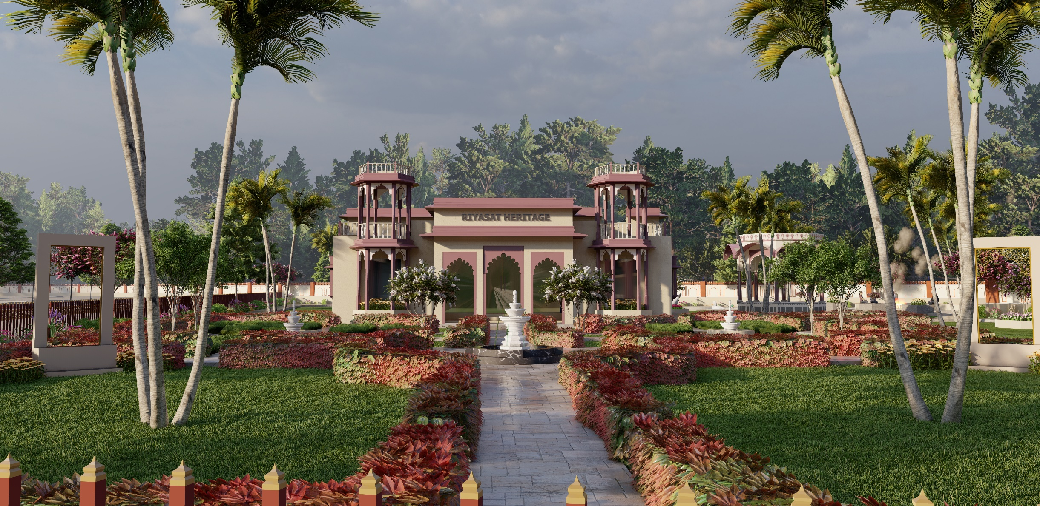
COMMUNITY HALL

Slide 9
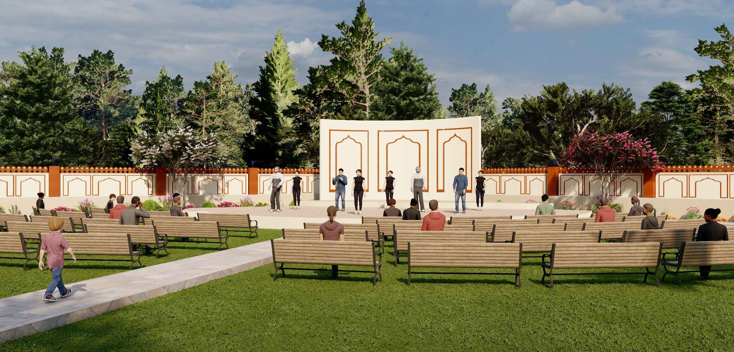
OPEN AIR THEATER

Slide 10
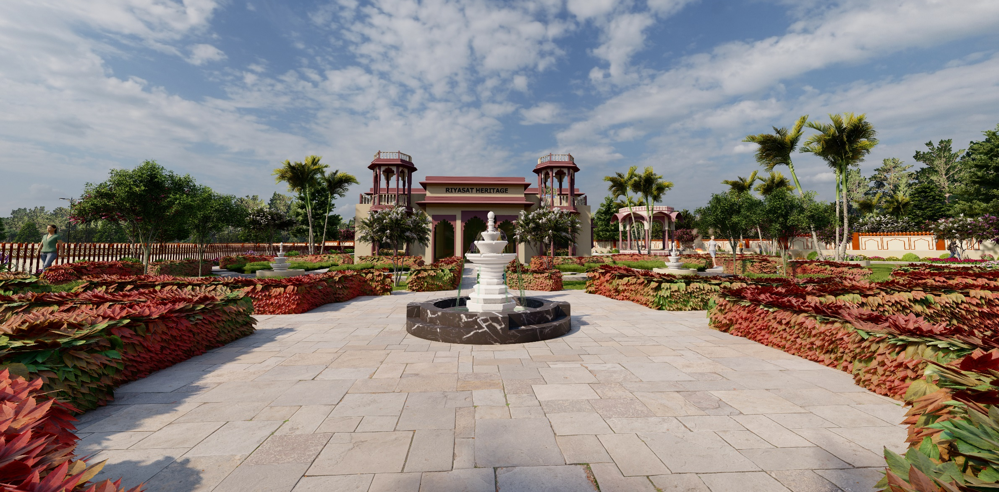
PARK FOUNTAIN

Slide 11
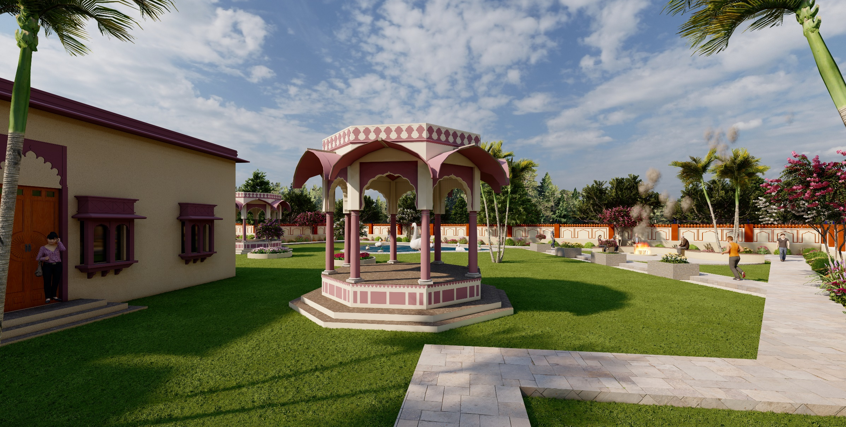
PARK PERGOLA

Slide 12
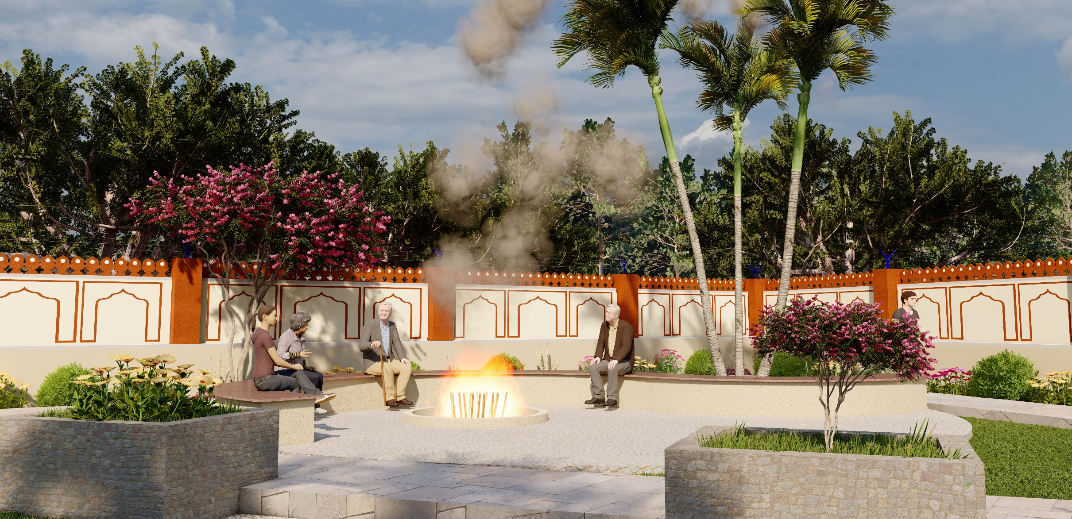
BONFIRE

Slide 13
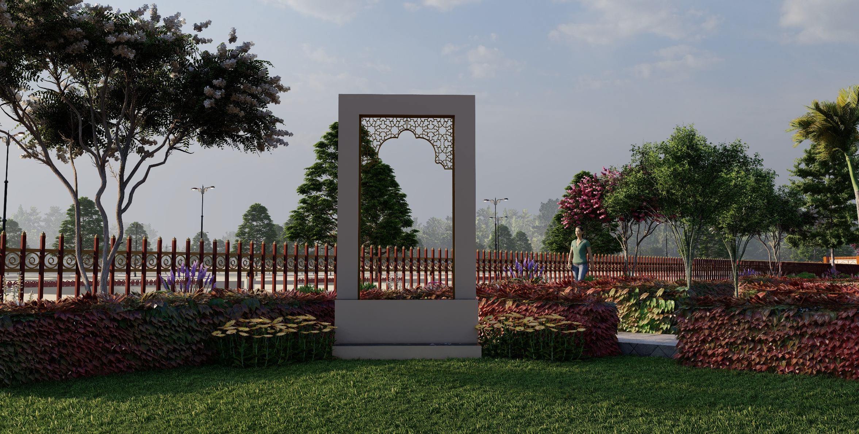
SELFIE POINT

Slide 14
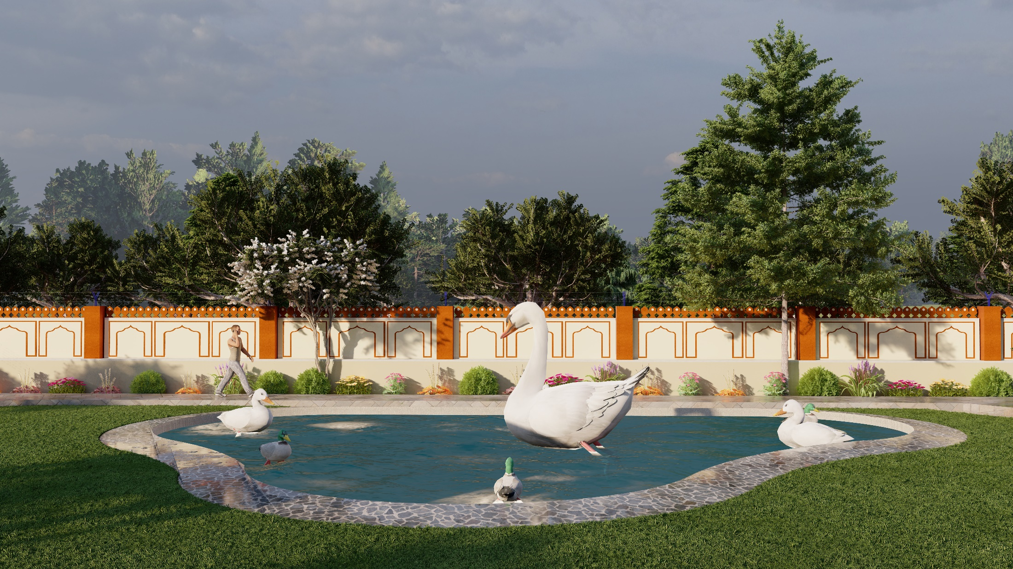
WATER POND

Slide 15
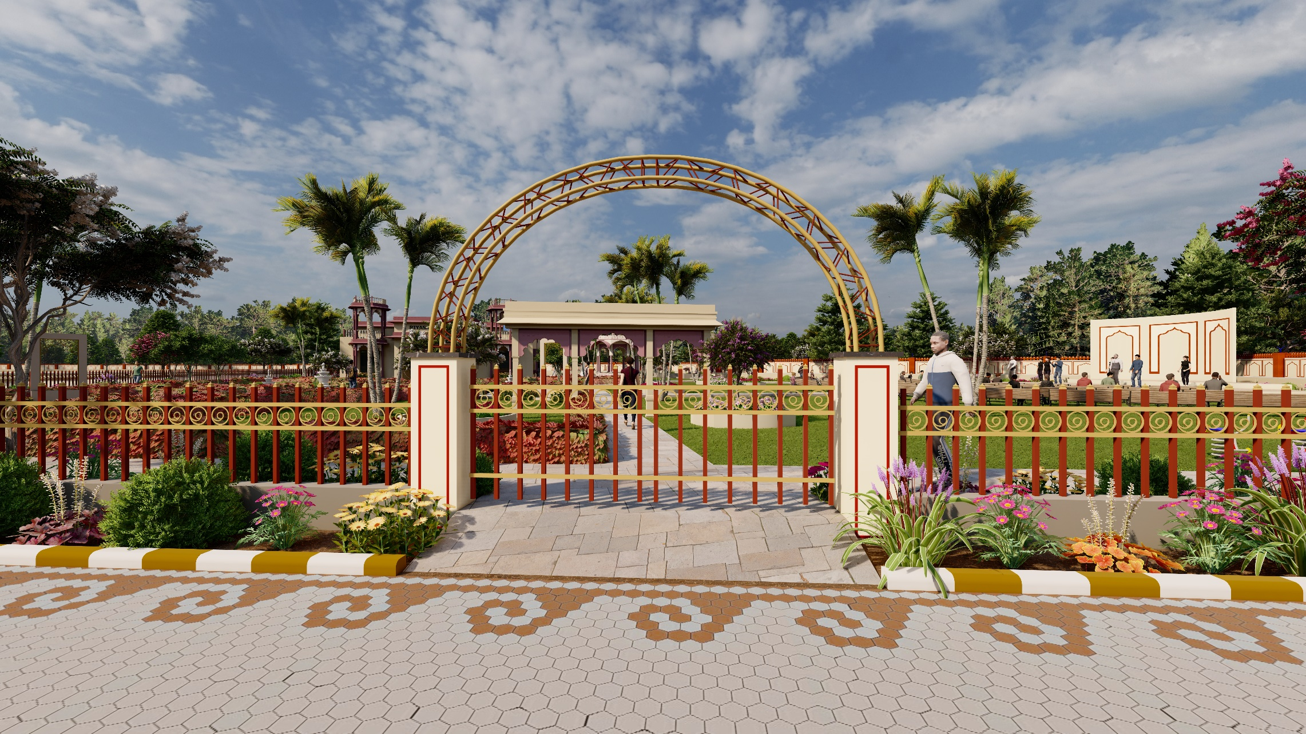
PARK ENTRY GATE PERGOLA

Slide 16
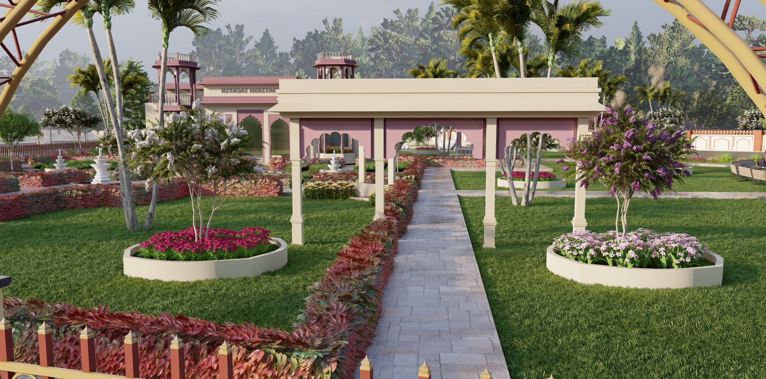
TORAN DWAR

Slide 17
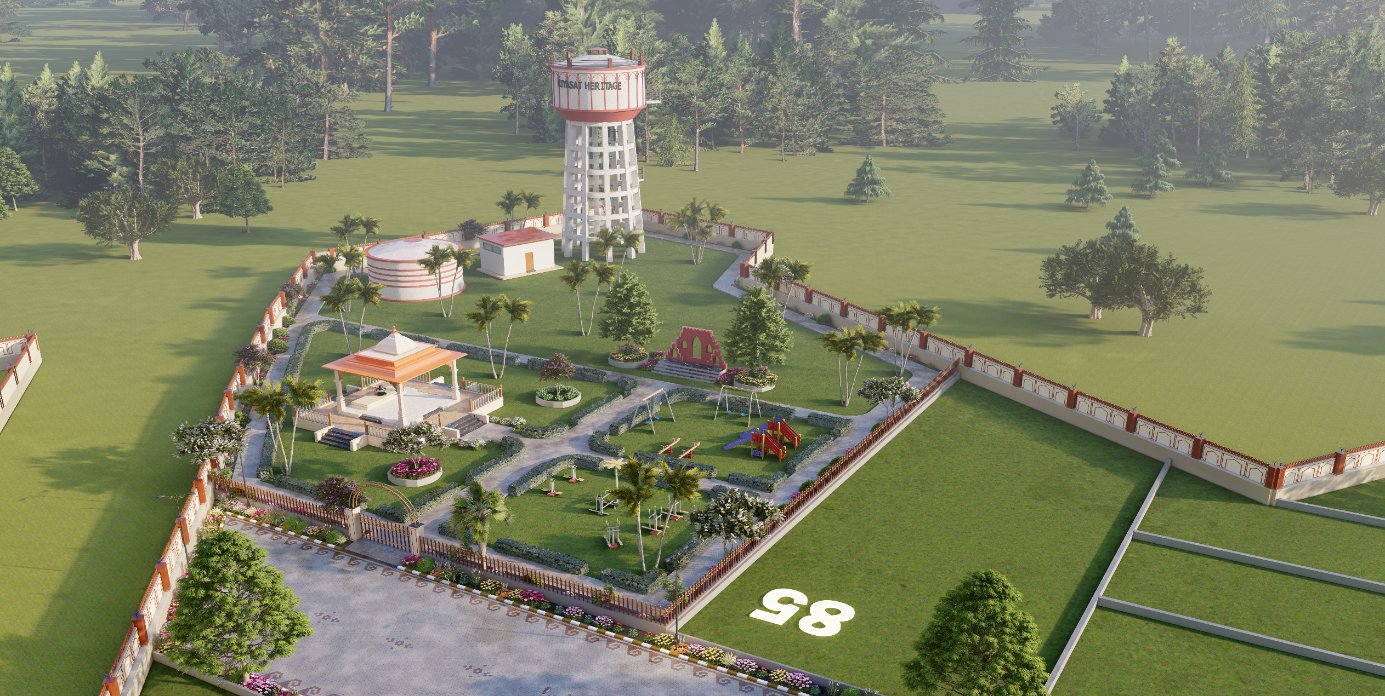
PARK AERIAL VIEW

Slide 18
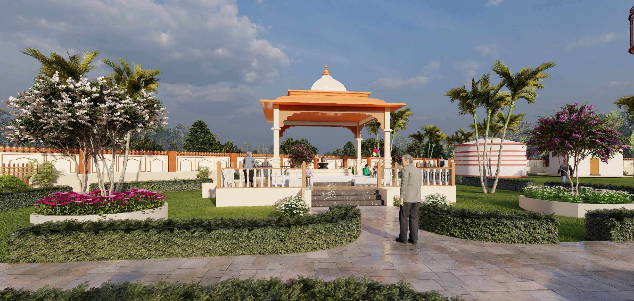
TEMPLE

Slide 19
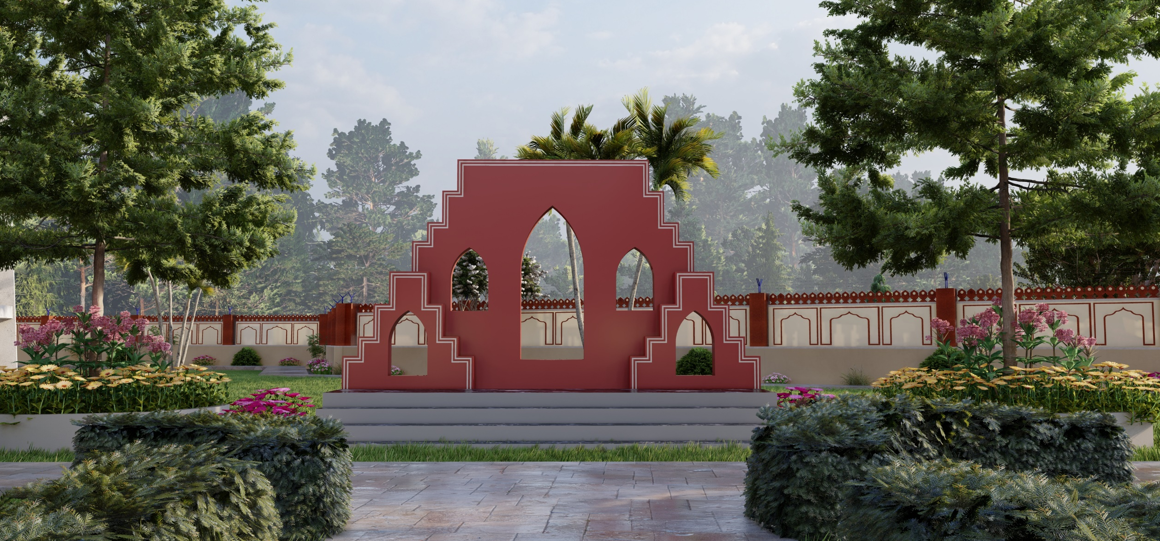
SELFIE POINT

Slide 20
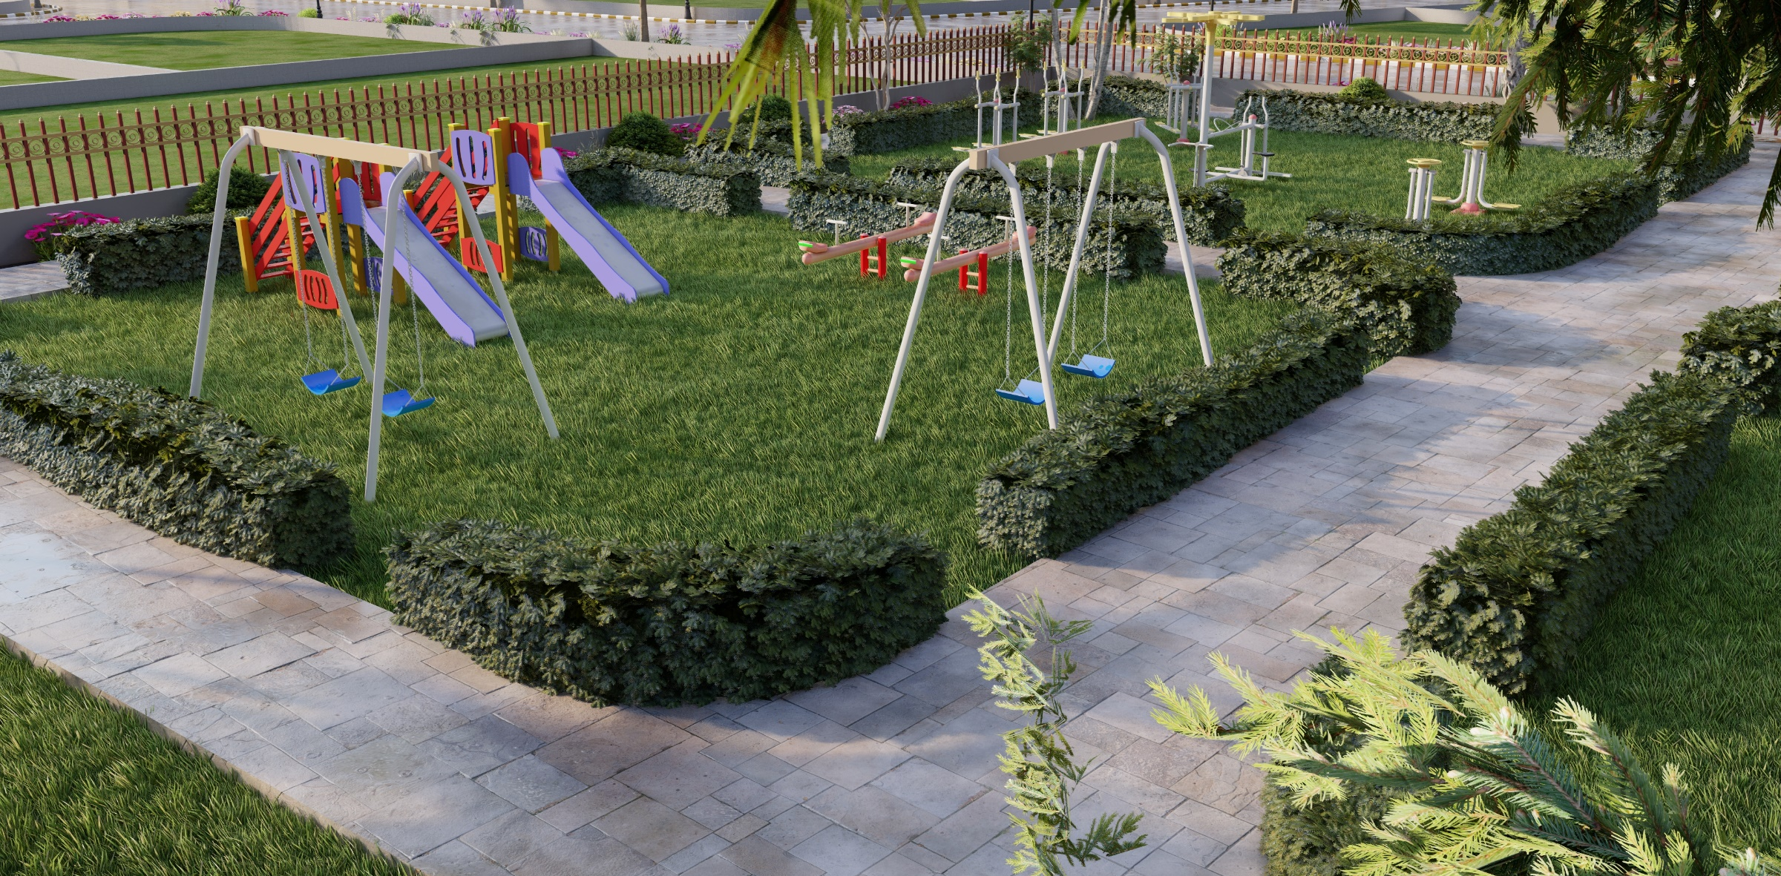
KIDS PLAY AREA

Slide 21
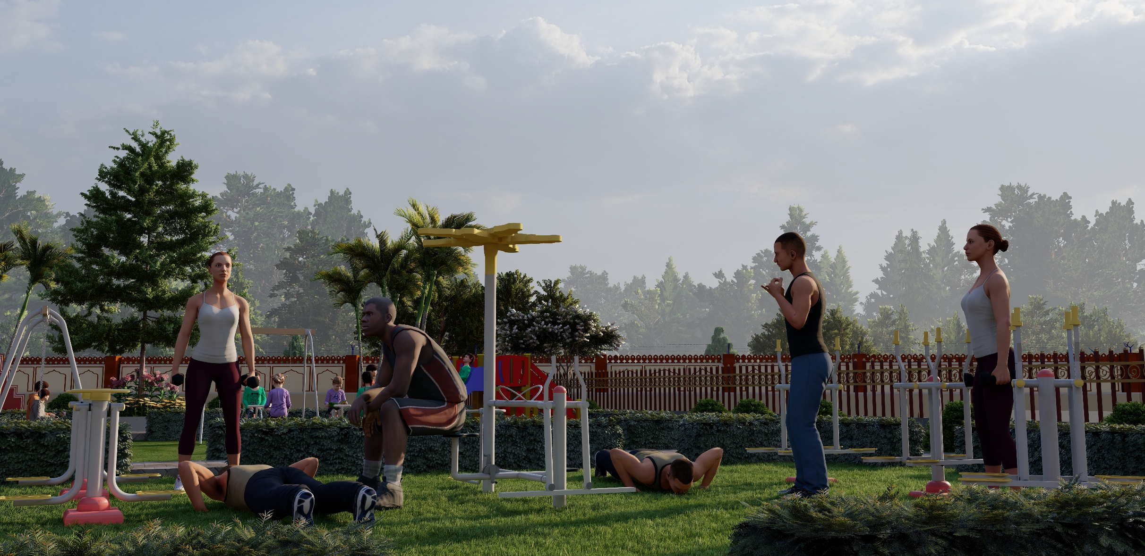
OPEN AIR GYM

Slide 22
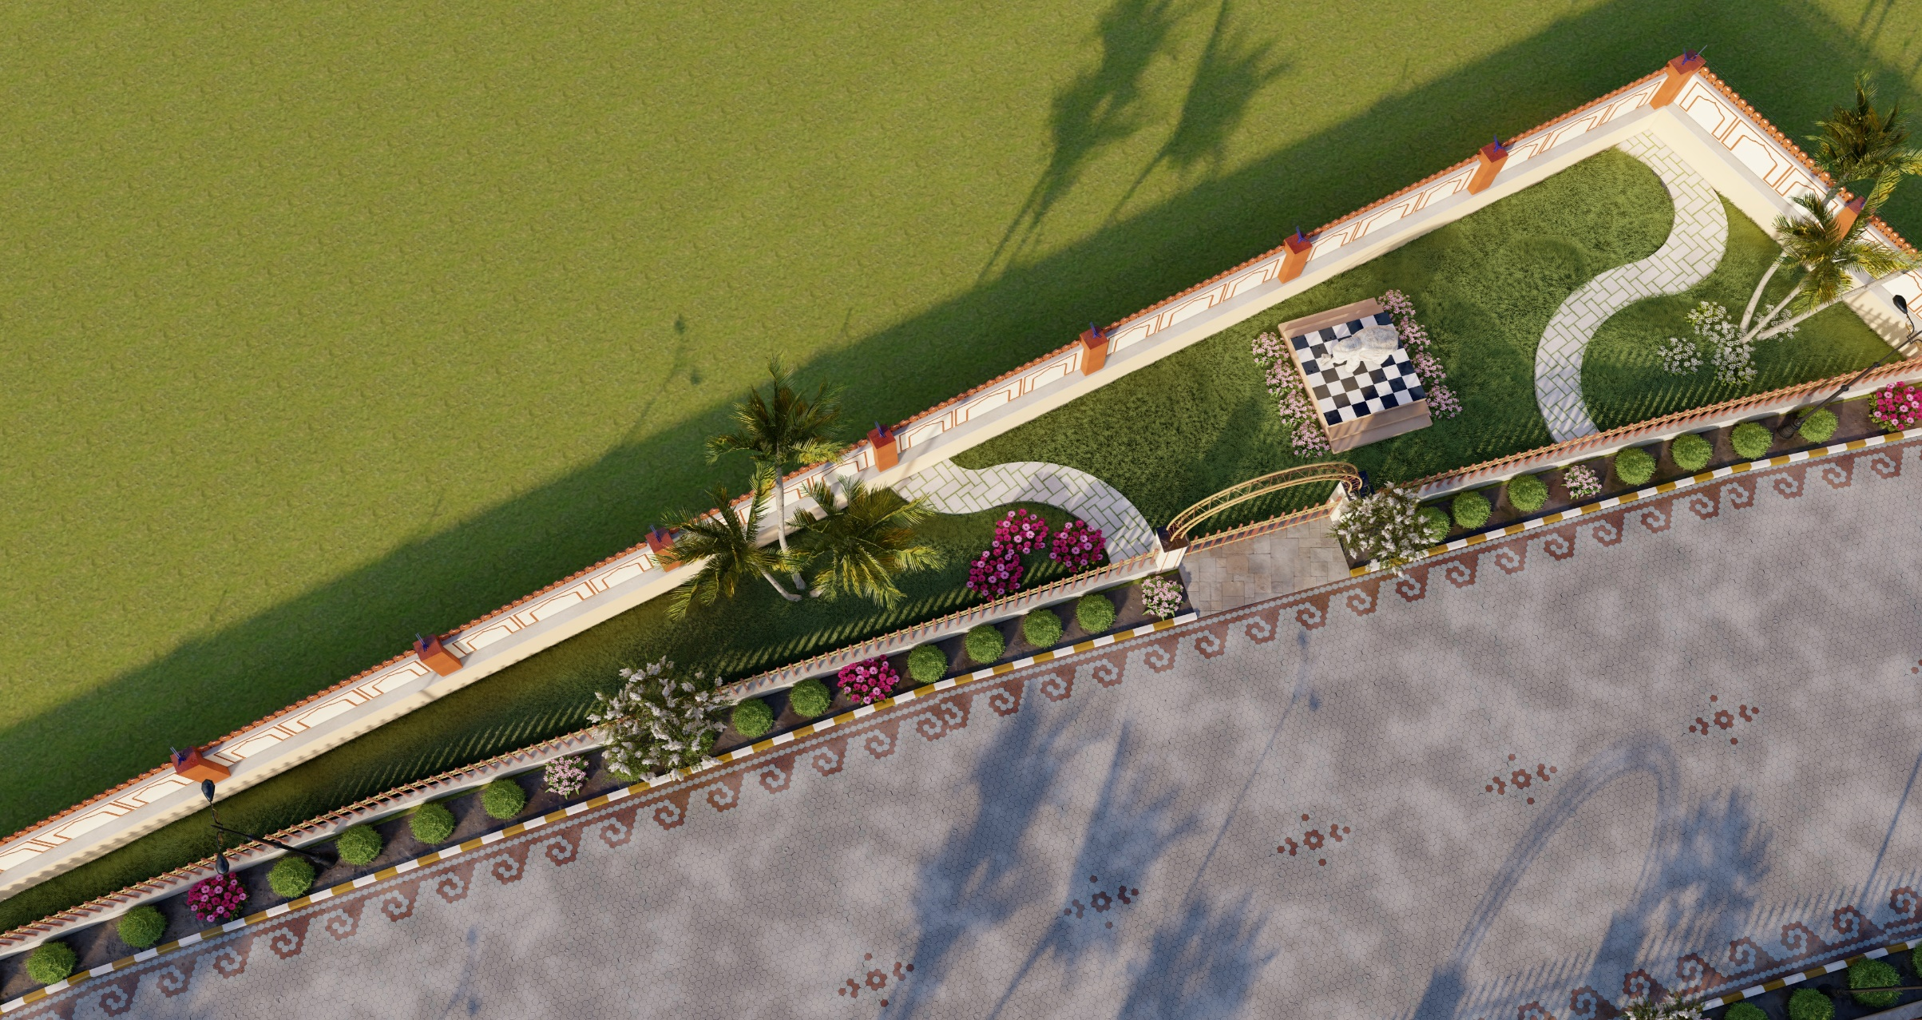
PARK AERIAL VIEW

Slide 23
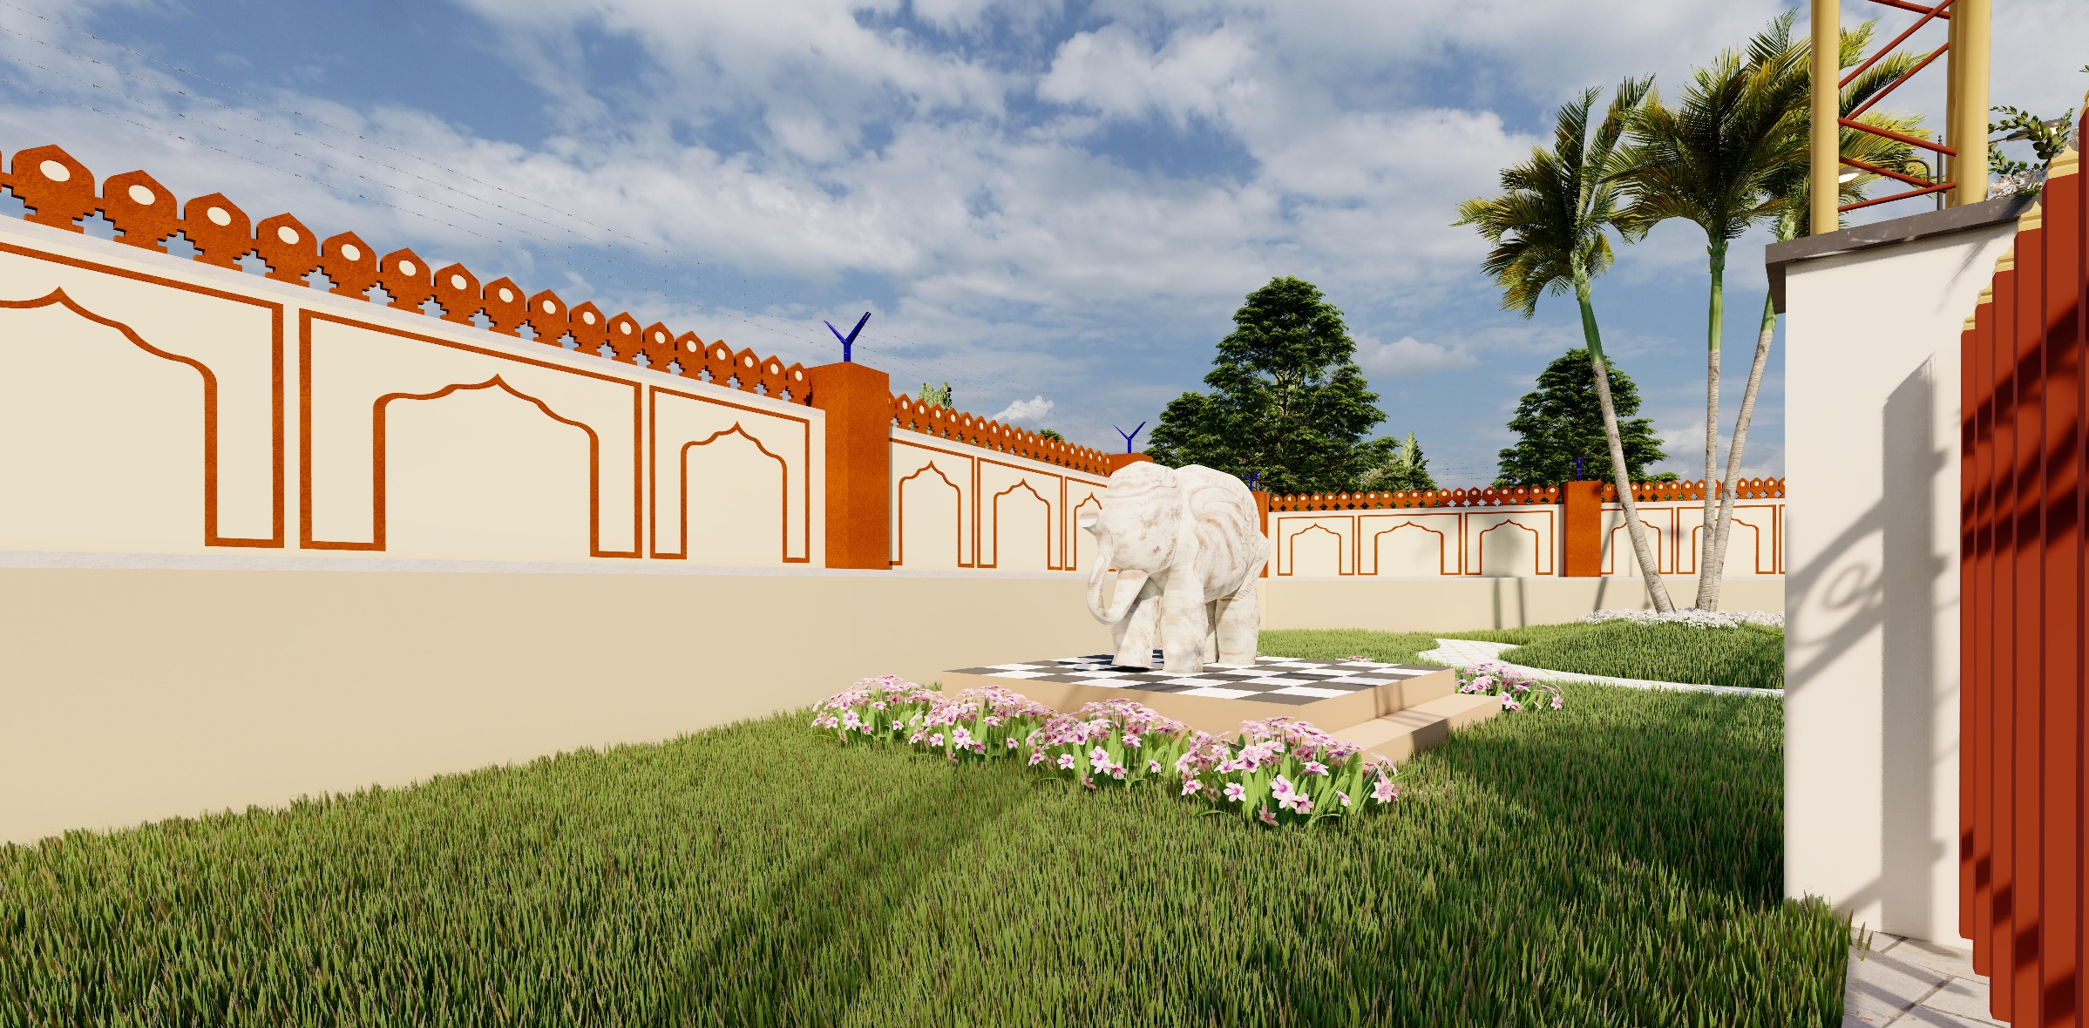
PARK STATUE

Slide 24
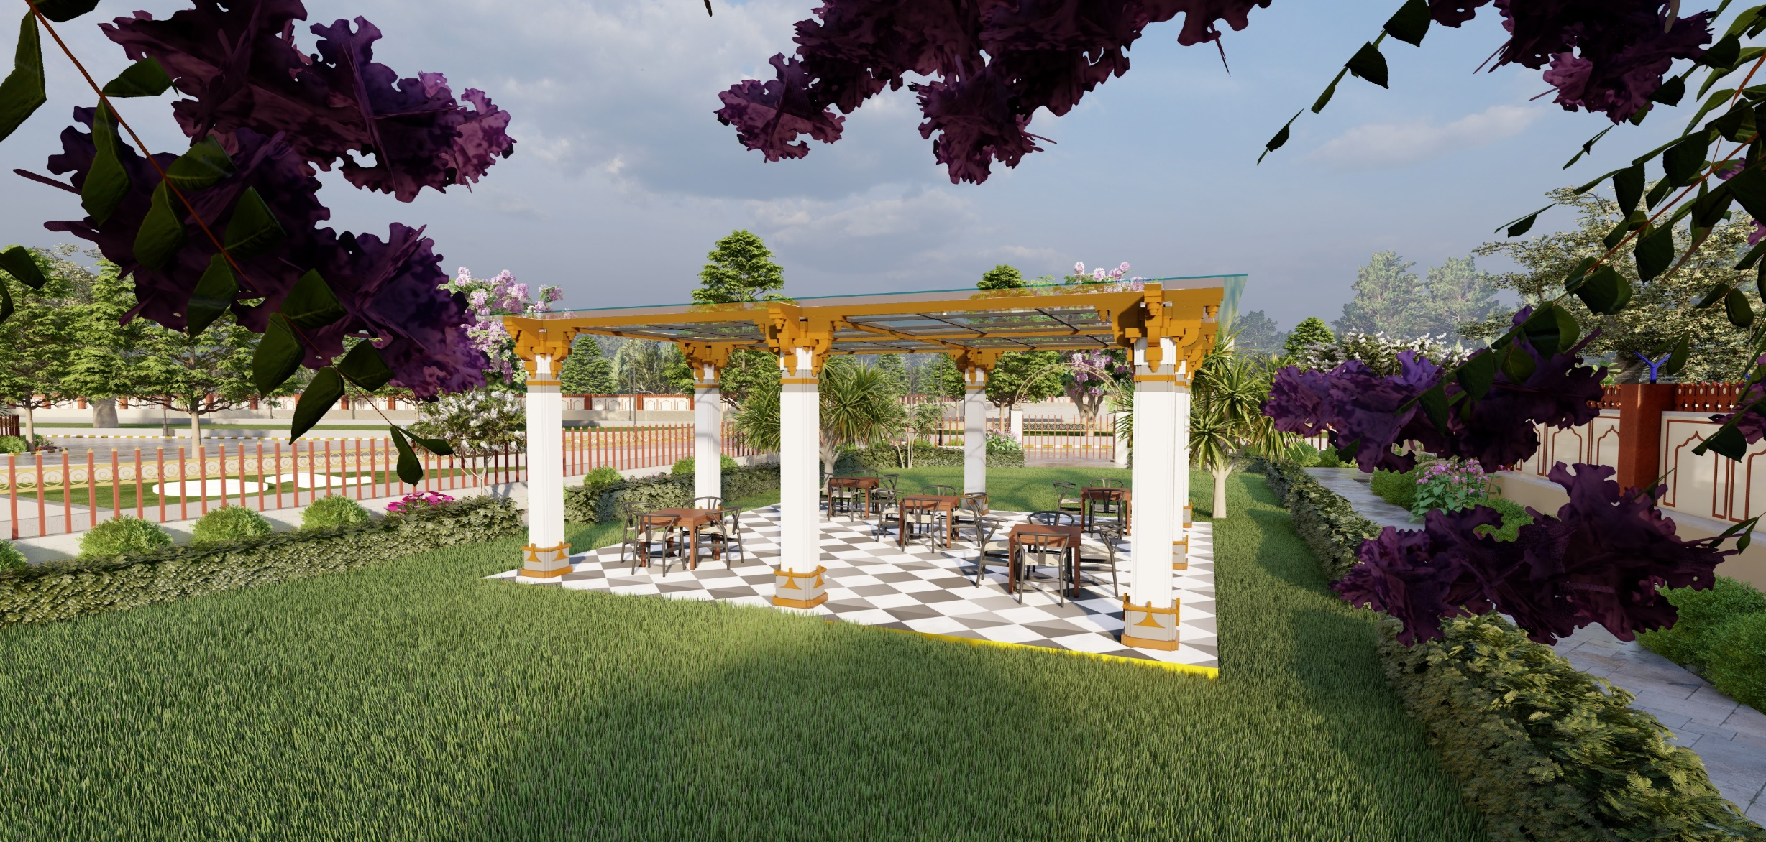
OPEN AIR RESTAURANT AREA

Slide 25
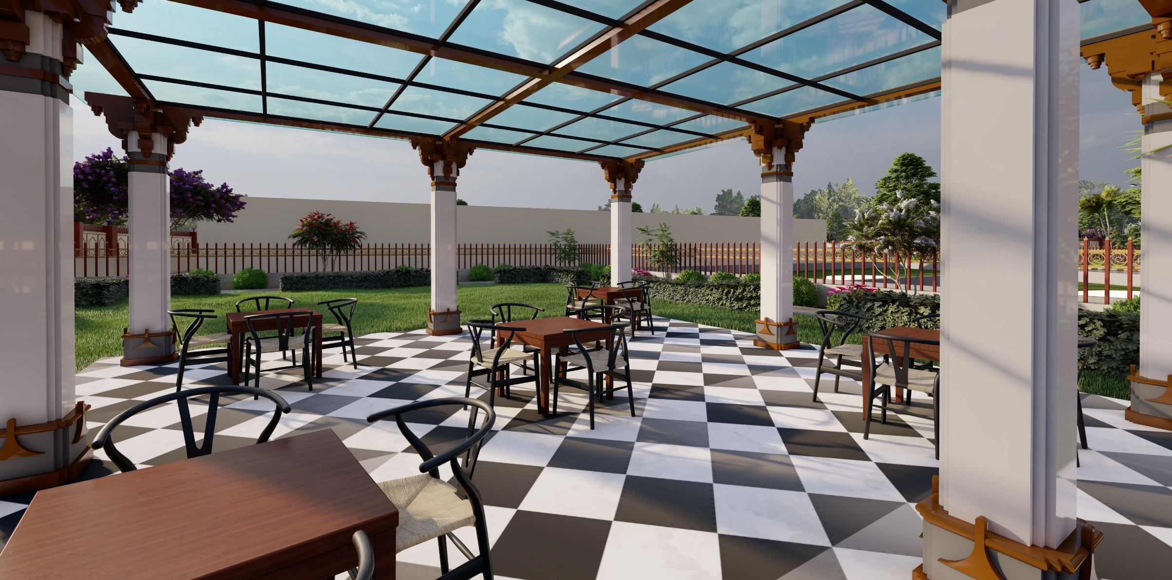
OPEN AIR RESTAURANT AREA

Slide 26
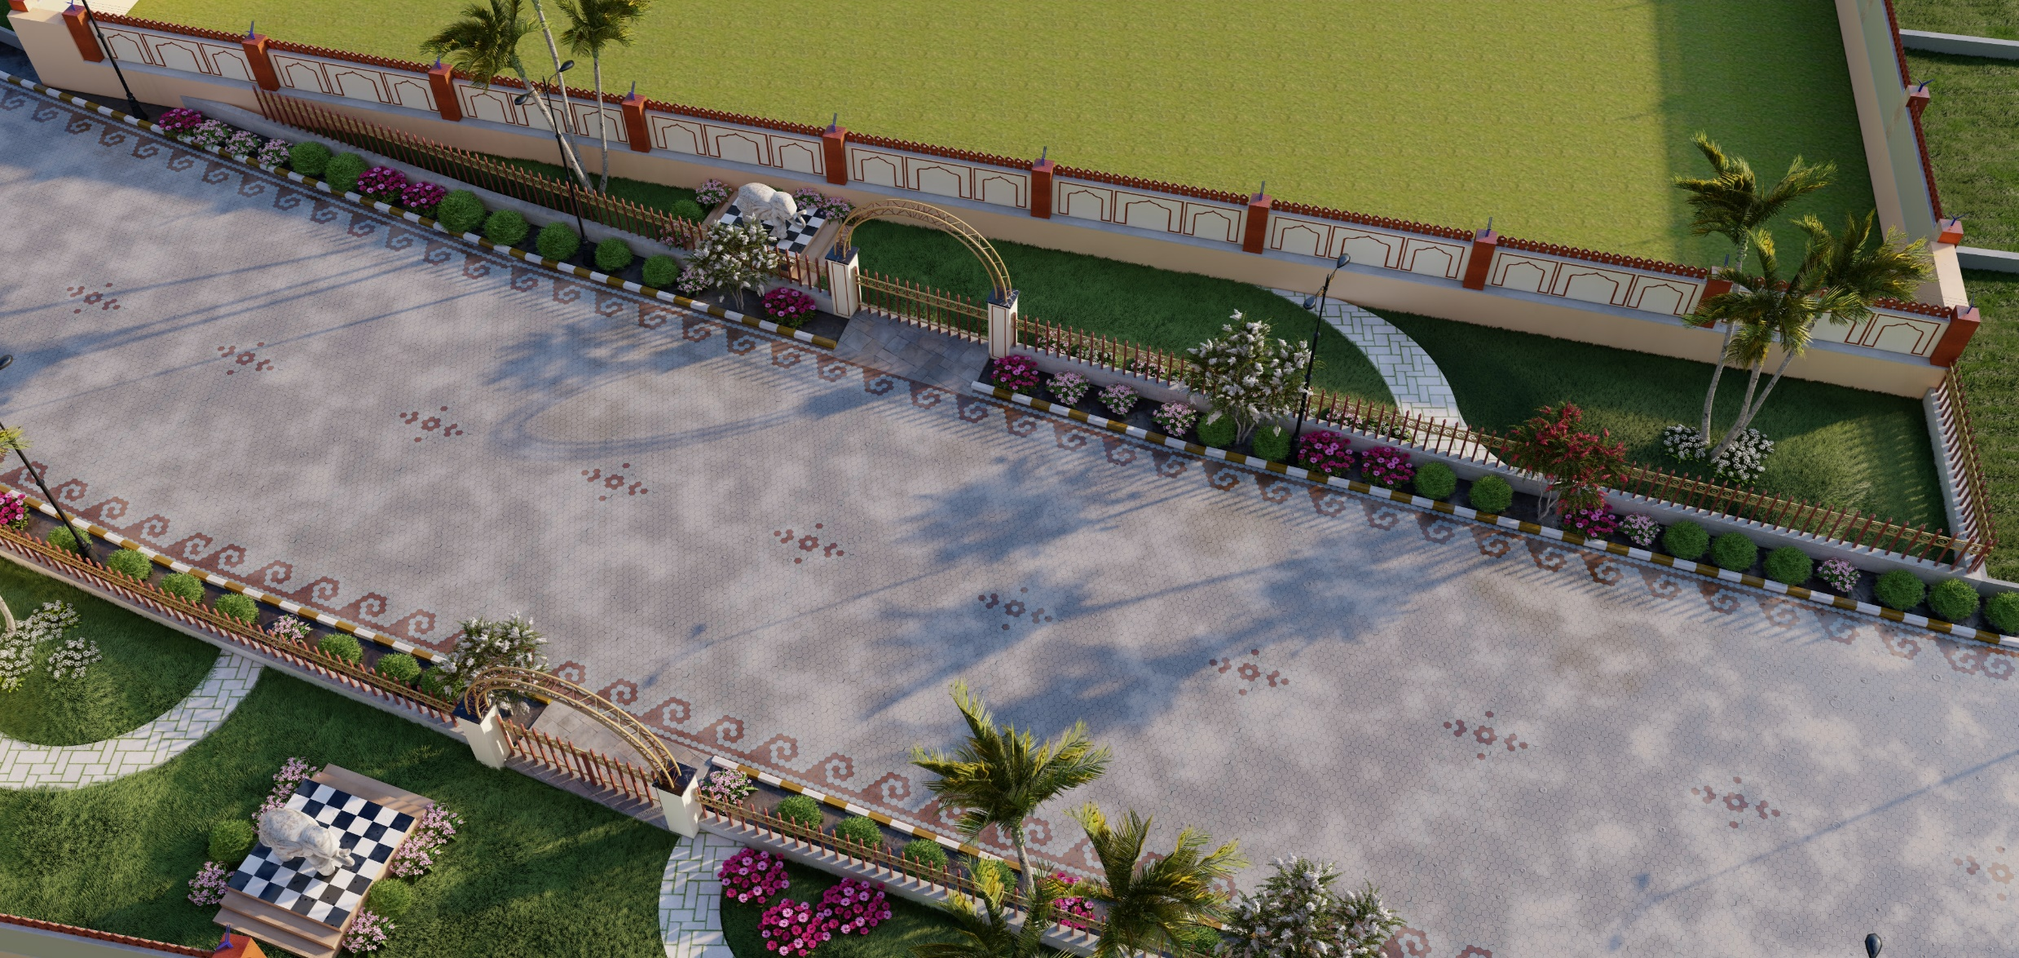
INTERLOCKING TILES ROAD

Slide 27
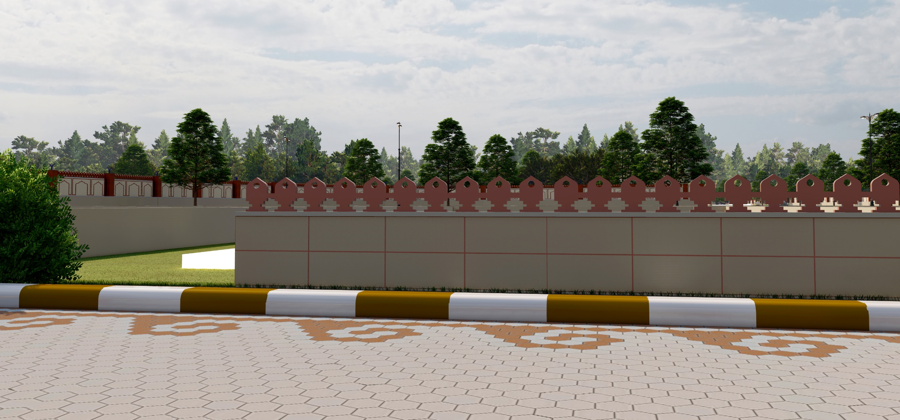
BLOCK BOUNDARY

Slide 28
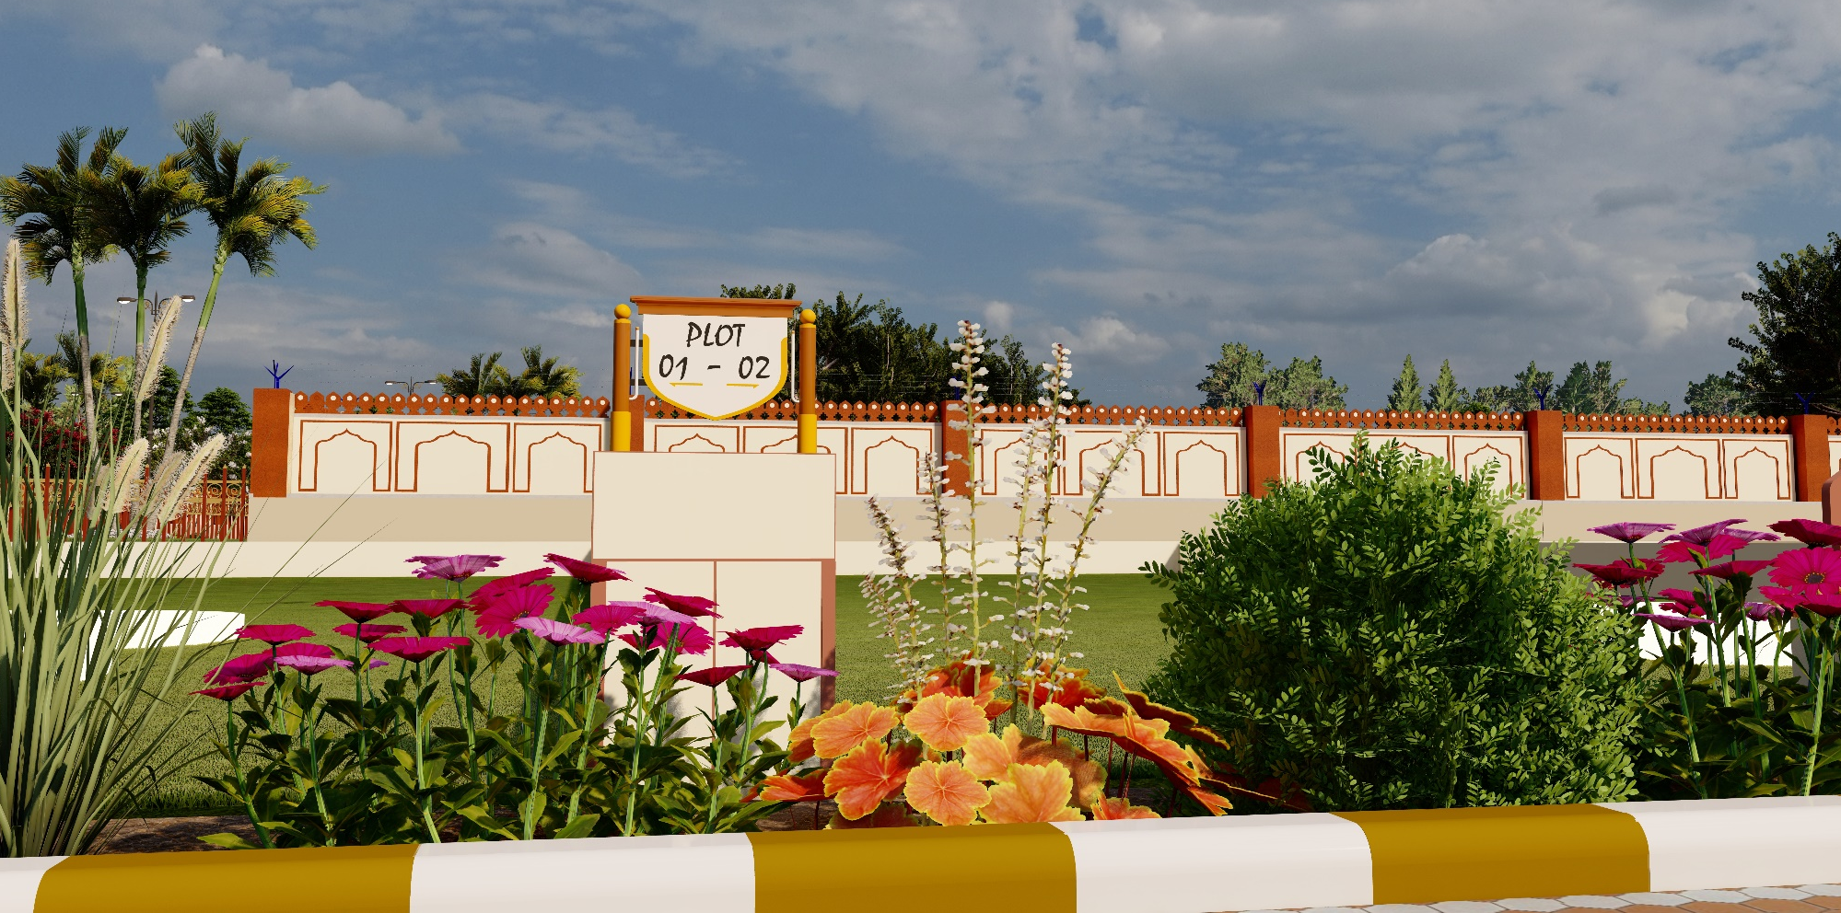
PLOT DEMARCATION

Slide 29
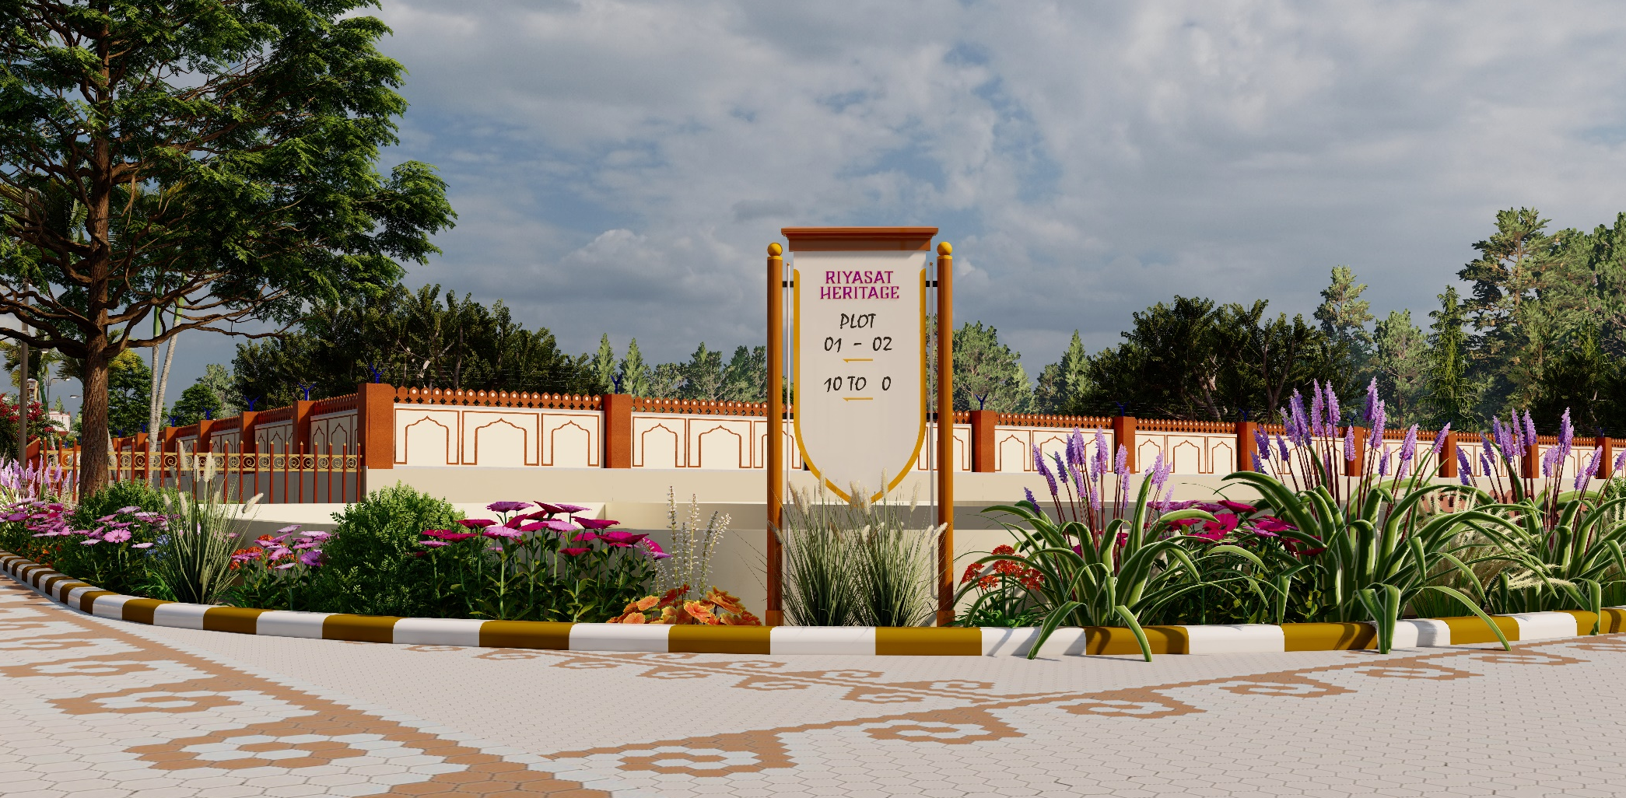
STREET DEMARCATION

Slide 30
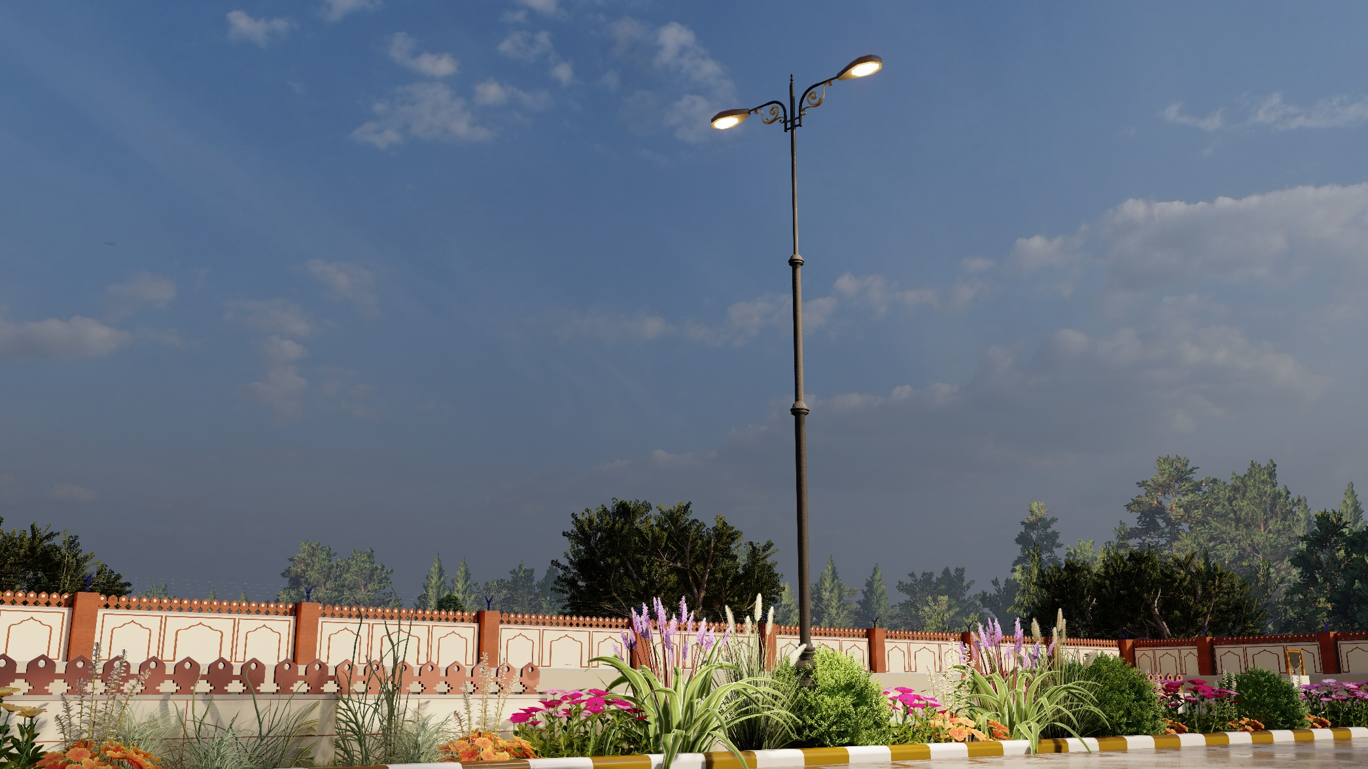
STREET LIGHT

Slide 31
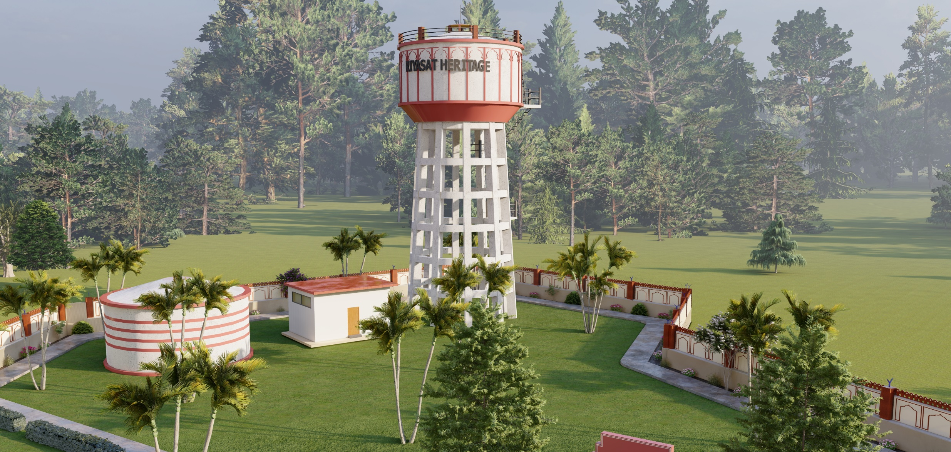
OHSR/CWR

Slide 32
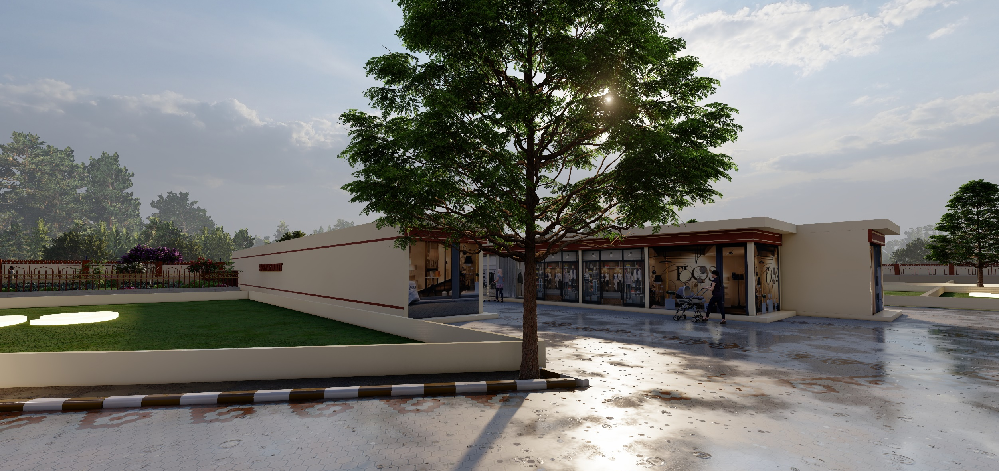
SHOPPING CENTER

Slide 33
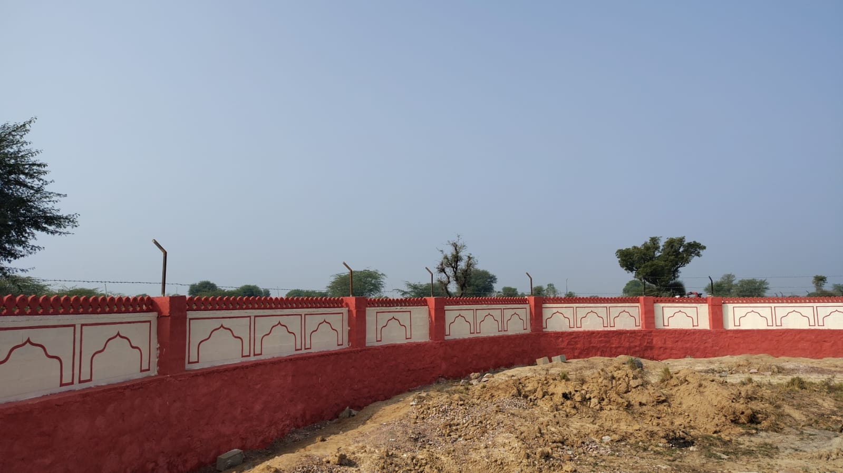
OUTER BOUNDARY ON SITE

Slide 34
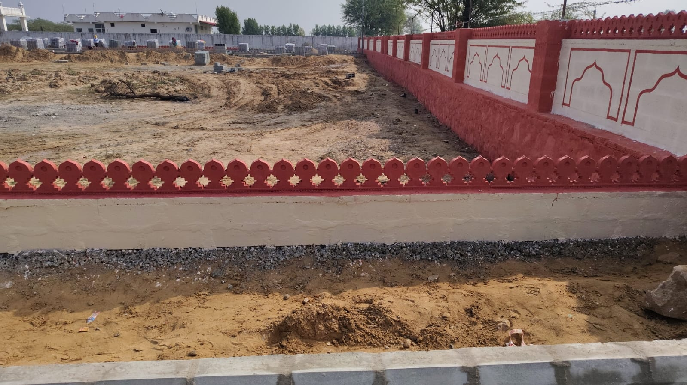
BLOCK BOUNDARY

Slide 35
EXTRA FACILITIES
UNDERGROUND HARVESTING LINE NETWORK WITH HARVESTING BOARING
UNDERGROUND SEWERAGE LINE NETWORK WITH STP
UNDERGROUND WATER SUPPLY NETWORK
UNDERGROUND ELECTRIFICATION SYSTEM
OHSR AND CWR
OUTER BOUNDARY
ENTRY GATE WITH BOOM BARRIER AND CCTV CAMERA
PLOT AND STREET SIGNAGE
PLOT BLOCK BOUNDARY
SOLAR SYSTEM FOR COMMON AREA
NOTE: ALL THE FACILITIES ARE COMMON FOR THE UPCOMMING PHASES OF THIS TOWNSHIP

Slide 36
THANK YOU

